Slide 1
ELECTRIC CHARGES AND FIELDS
CLASS-XII
PHYSICS

Slide 2
ELECTROSTATICS
Electrostatics deals with the study of forces, fields and potentials arising from static charges.
Electric charges are of two types
Positive Charge
Negative Charge
Like charges repel each other
Unlike charges attract each other

Slide 3
ELECTROSTATICS
By convention, the charge of electron is considered as negative and charge of proton is considered as positive
The substances which allow electricity to pass through them are called conductors
The substances which do not allow electricity to pass through them are called insulators

Slide 4
ELECTROSTATICS
Electric charge is a basic property of matter
Basic Properties of Electric Charge
Additivity of charges- If a system contains two point charges q1 and q2,the total charge of the system is obtained simply by adding algebraically q1 and q2
Charge is conserved- For an isolated system, the net charge of the system remains constant
Quantisation of charge- The fact that electric charge is always an integral multiple of e is termed as quantisation of charge

Slide 5
Coulomb’s Law
Coulomb found that the electric force between two charged objects is
Proportional to the product of the charges on the objects, and
Inversely proportional to the separation of the objects squared
F = kq1q2/r2
k being a proportionality constant, having a value of 8.988 x 10⁹ Nm²/c²

Slide 6
Electric Force
As with all forces, the electric force is a Vector
The direction of the force is either parallel or antiparallel to the unit vector depending upon the relative signs of the charges

Slide 7
Superposition of Forces
If there are more than two charged objects interacting with each other
The net force on any one of the charged objects is the vector sum of the individual Coulomb forces on that charged object
This is called superposition principle

Slide 8
Electric Field
The Electric Force is like the Gravitational Force
The electric force can be thought of as being mediated by an electric field.
A Field is something that can be defined anywhere in space

Slide 9
Electric Field
We say that when a charged object is put at a point in space,
The charged object sets up an Electric Field throughout the space surrounding the charged object
It is this field that then exerts a force on another charged object

Slide 10
Electric Field Lines
An imaginary line that at any given point has its tangent being in the direction of the electric field at that point
At any given point, there can be only one field line
The electric field has a unique direction at any given point
Electric Field Lines
Begin on Positive Charges
End on Negative Charges

Slide 11
Electric Field Lines

Slide 12
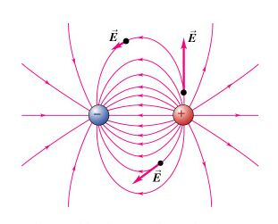
Electric Dipole
An electric dipole is a pair of point charges having equal magnitude but opposite sign that are separated by a distance d.

